Slide 1

30th Jan 2025
Unveiling
Data Science
PREPARED BY
Mengyao Zhang, Anting Zhu, lingjia Li, Nuan Leng, Xintong Du, Yuanxi Luo

Slide 2
Outline
Unveiling Data Science
Definition of Data Science
Position of Data Science
The Data Scientist
Principles of Data Science
Data Processing and System Architecture
Diversity of Data and Value Extraction

Slide 3
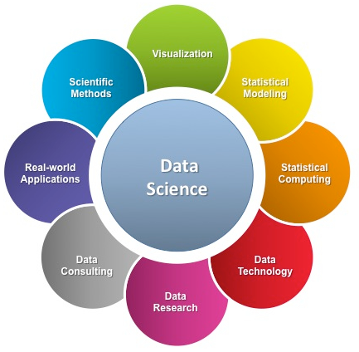
Part1 Definition of Data Science
Unveiling Data Science
Inclusive analysis
Extract information
Get insights from data

Slide 4
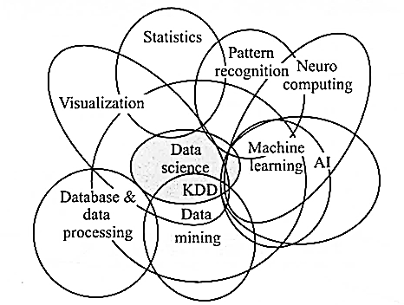
Part2 Position of Data Science
Unveiling Data Science
An interdisciplinary field^{[1]}
Theories
Technologies
Harmonious and coherent theoretical system

Slide 5
Part2 Position of Data Science
Unveiling Data Science
Databases, Big Data^{[2]}
VS
Data Science
 | Databases | Big Data | Data Science
Purpose | CRUD operations | Handling massive, complex, and diverse datasets | Developing new methodologies and theoretical frameworks
Characteristics of Data | Structured data | Volume, Variety, and Velocity | All types and sizes of data
Technology | Traditional DBMS(e.g. SQL) | Specialized frameworks and tools(e.g. Hadoop, Spark) | Combination of statistical techniques, machine learning algorithms, and programming tools(e.g. Python)
Focus | Operational efficiency | Scalability | Value extraction

Slide 6
Part2 Position of Data Science
Unveiling Data Science
Data Science
&
Data-Driven Decision Making (DDD)
DDD
Data science:
principles, processes, techniques, tools
Data
The ultimate goal of data science is improving decision making^{[2]}.

Slide 7
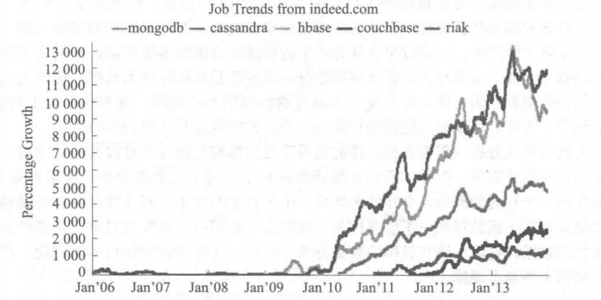
Part3 The Data Scientist
Unveiling Data Science
The rise of big data technologies and the advent of data science.
The Data Scientist
The demand for data scientists ： increasing

Slide 8
Part3 The Data Scientist
Knowledge in specific areas
Mathematical Foundation
Programming Skills
Data Scientists’ Requirments

Slide 9
Part3 The Data Scientist
Math and Statistical Analysis
Knowledge in specific areas
AI and Machine Learning
Database and Data Mining

Slide 10
Part3 The Data Scientist
Understand Data
Collect Data
Full - cycle Data Processing Skills
Integrate Data
Analyze Data
Visualize Result
Communicate Result

Slide 11
Part4 Principles of Data Science
Unveiling Data Science
Data Can Be Divided into Distinct Stages
Descriptive and Predictive Analysis
Entity Similarity
Model Generalization Ability

Slide 12
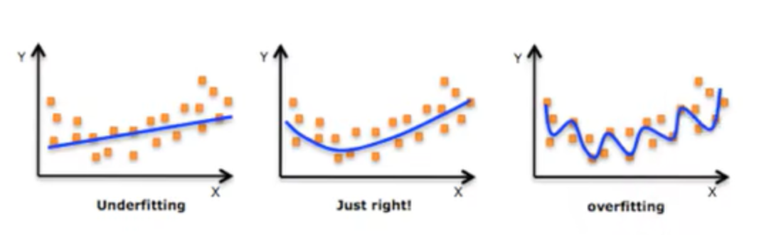
Part4 Principles of Data Science
Unveiling Data Science
An example for principle 4

Slide 13
Part4 Principles of Data Science
Unveiling Data Science
5. Evaluation is Application-Specific
6. Correlation Does Not Imply Causation
7. Parallel Processing for Efficiency

Slide 14
Part5 Data Processing and System Architecture
Unveiling Data Science
A complete data processing workflow:
Data Collection
Data
Representation & Storage
Data Cleaning & Integration
Insights & Decision Making
Data Visualization
Data Analyzing

Slide 15
Part5 Data Processing and System Architecture
Unveiling Data Science
Layered Architecture of Data Processing Systems:
Application Software, Data Products
Storage, Retrieval, and Analysis Software (Computing Device)
Database (Storage Device)

Slide 16
Part5 Data Processing and System Architecture
Unveiling Data Science
Lambda Architecture of Data Processing Systems:
Batch Layer
Serving Layer
query
Batch view
Master dataset
new
data
Batch view
query
Speed Layer
Real-time view
query
Real-time view

Slide 17
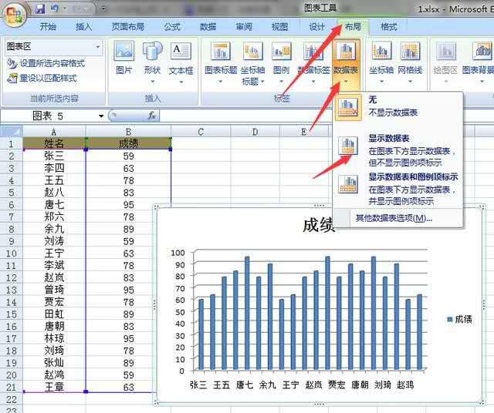


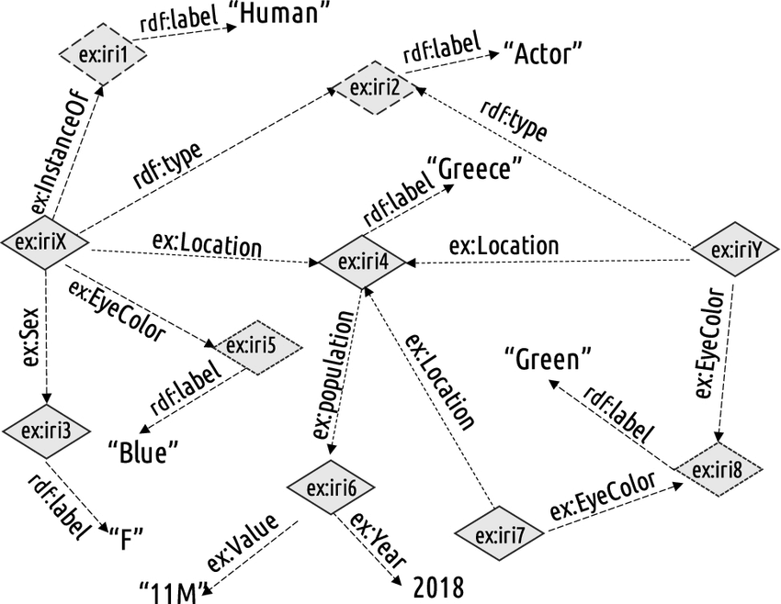


Part6 Diversity of Data and Value Extraction
Unveiling Data Science
table date
HTML file
XML file
text date
multimedia date
RDF date

Slide 18
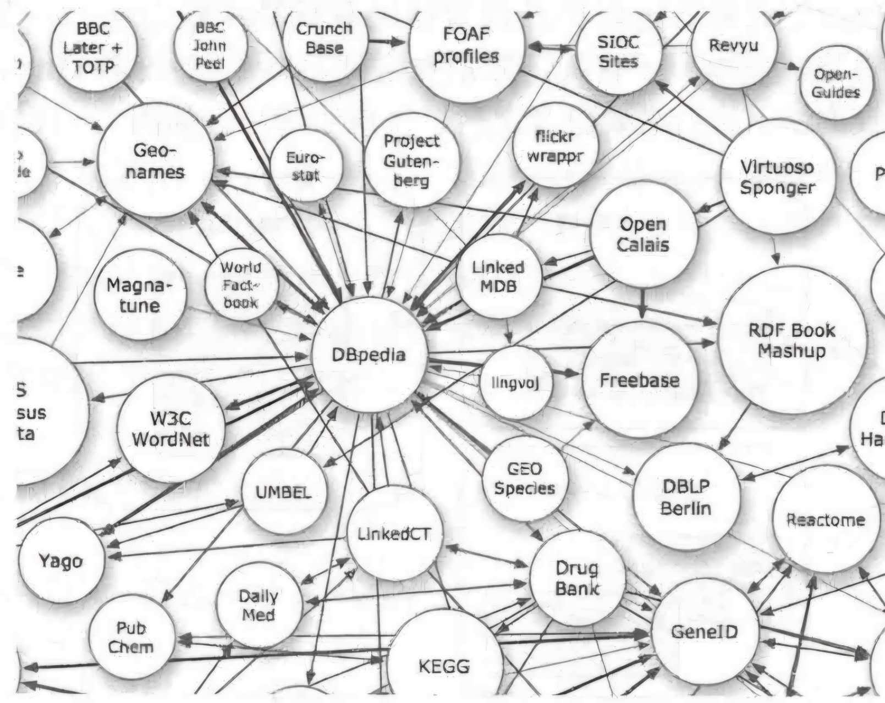
Part6 Diversity of Data and Value Extraction
Unveiling Data Science
Linked Open Date Program

Slide 19
Part6 Diversity of Data and Value Extraction
Unveiling Data Science
Raw date: voluminous, low value
clean & integrat
simply analyze
Cleaned, integrated date
Metrics&report
complexly analyze
Insights: pattern, correlation
general rule
Konwledge, high value

Slide 20
References
Unveiling Data Science
[1] Egger, R., Yu, J. (2022). Data Science and Interdisciplinarity. In: Egger, R. (eds) Applied Data Science in Tourism. Tourism on the Verge. Springer, Cham. https://doi.org/10.1007/978-3-030-88389-8_3
[2] Provost, Foster, and Tom Fawcett. "Data Science and its Relationship to Big Data and Data-Driven Decision Making." Big Data, vol. 1, no. 1, 2013, pp. 51-59. doi:10.1089/big.2013.1508.
[3] Qin, X., Chen, Y., & Du, X. Shu ju ke xue gai lun [Introduction to Data Science].

Slide 21
30th Jan 2025
Unveiling
Data Science
Thank you! Your comments and suggestions are appreciated.
PREPARED BY
Mengyao Zhang, Anting Zhu, lingjia Li, Nuan Leng, Xintong Du, Yuanxi Luo

